Slide 1
Polymorphic Event Patterns for C/AL
Vjekoslav Babić
Microsoft Dynamics NAV MVP

Slide 2

Polymorphism?

Slide 3
Polymorphic patterns
Producer-Consumer
Delegation
Strategy
Command
Prototype
Service Locator
Factory
Proxy
Twin
Provider
Dependency Injection
Builder
Facade
Visitor
Bridge
Composite
Transfer Object
Servant
Plug-in
Repository
Template Method
Mediator

Slide 4
Object-Oriented Polymorphism
Subtyping polymorphism
Interface polymorphism

Slide 5
Object-Oriented Polymorphism
Subtyping Polymorphism
Interface Polymorphism
public class Vehicle
{
public virtual void Start() { }
public virtual void Stop() { }
}
public class Car : Vehicle
{
public void Honk() { }
}
public class Bicycle : Vehicle
{
public void Ring() { }
}
public interface IVehicle
{
void Start();
void Stop();
}
public class Car : IVehicle
{
public void Start() { }
public void Stop() { }
public void Honk() { }
}
public class Bicycle : IVehicle
{
public void Start() { }
public void Stop() { }
public void Ring() { }
}

Slide 6
Polymorphic design patterns (most common)
Factory pattern
Service locator pattern
Strategy pattern
Dependency injection
Template method pattern
Inversion of Control

Slide 7
Inversion of Control - Problem
Dependency 2
What do I do now?
Recompile?
What about that one?
Consumer Object
(uses a dependency)
Dependency 1
tightly-bound
(compile time)
This is obviously a bad practice!

Slide 8
Inversion of Control - Solution
Dependency 1
Consumer Object
(needs a dependency)
Dependency Resolver
(retrieves dependency)
Dependency 2
loosely bound
(run time)
Problem solved!
Dependency n...

Slide 9
Sad Truth About Polymorphism in C/AL
”There is no such thing as polymorphism in C/AL.”
(some very astute C/AL developer)

Slide 10
Okay, but we do get close...
Argument Table
https://community.dynamics.com/nav/w/designpatterns/245.argument-table
Facade
Variant Facade
https://community.dynamics.com/nav/w/designpatterns/246.variant-facade
TempBlob Facade

Slide 11
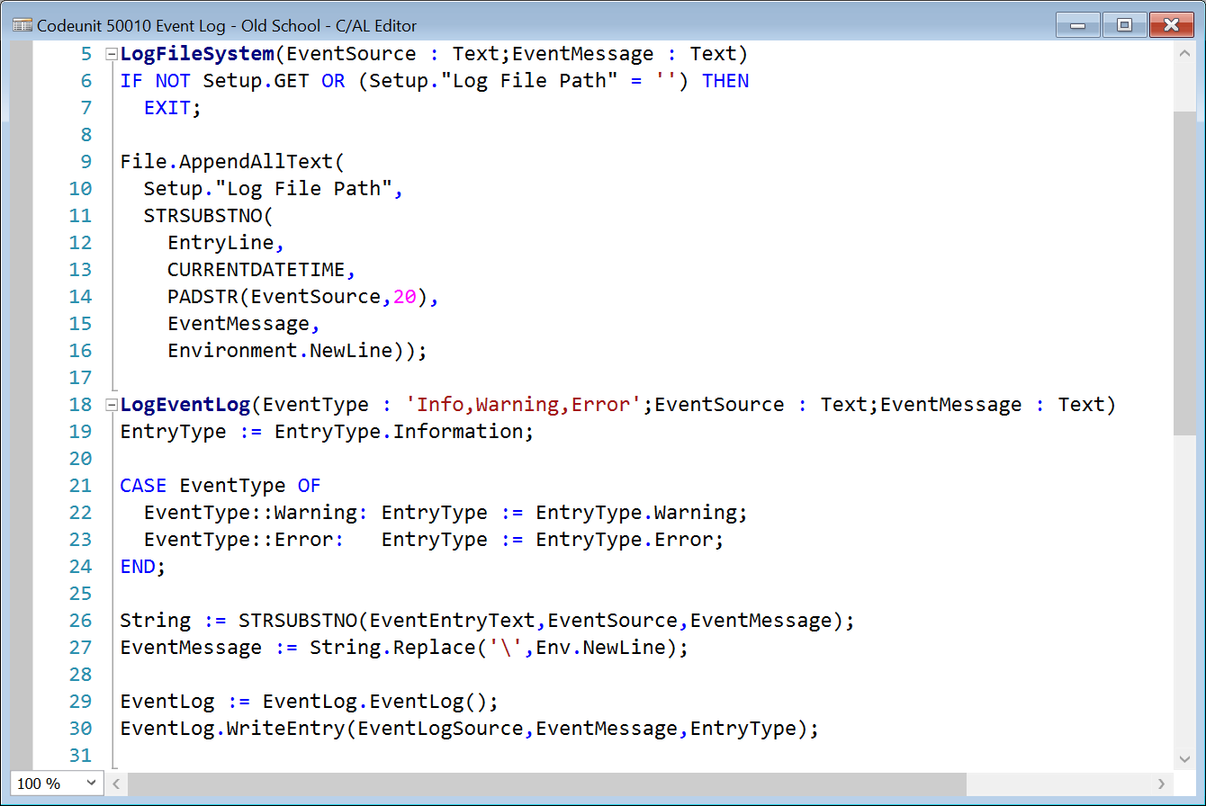
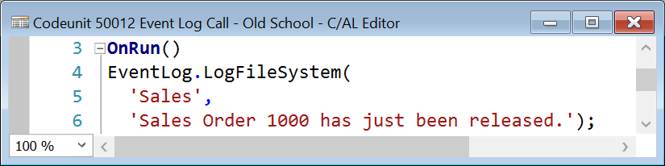
Consider this...

Slide 12
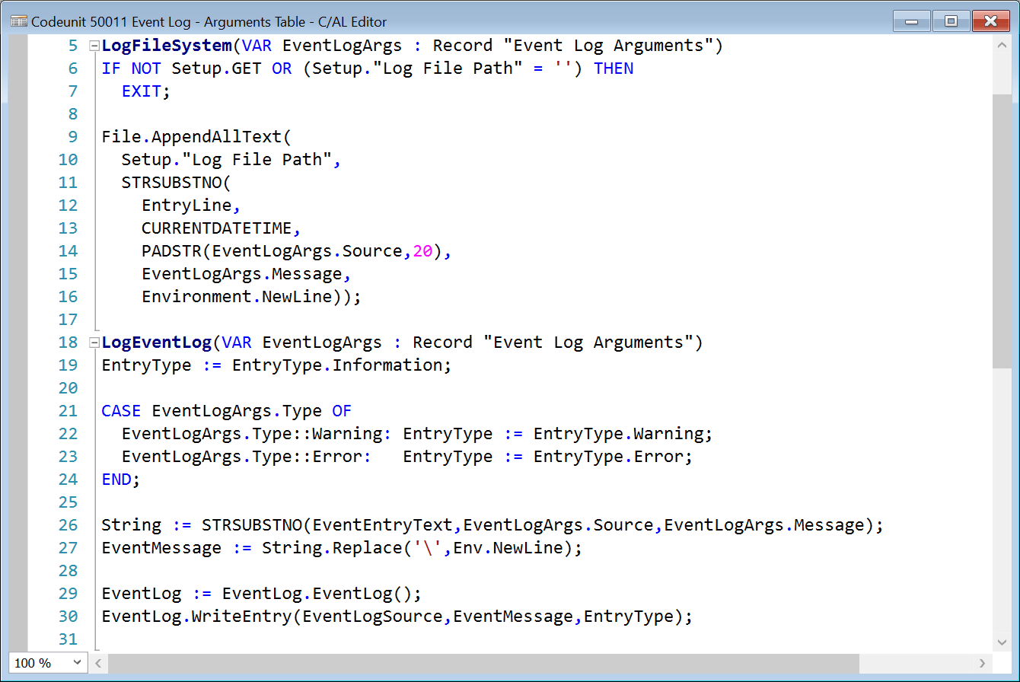
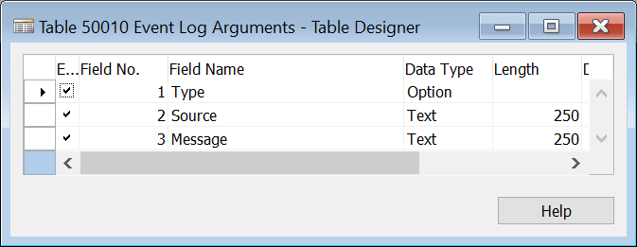
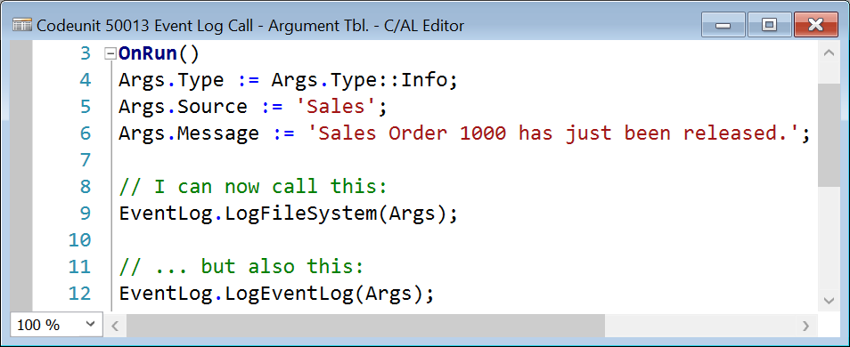
A Closer Look: Argument Table

Slide 13
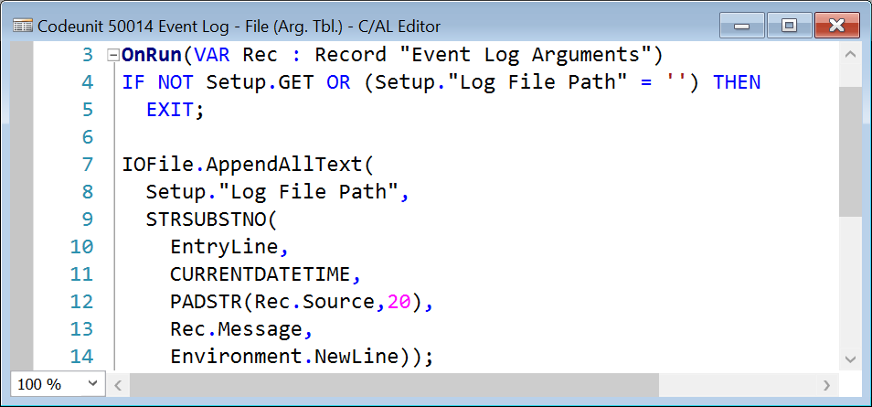
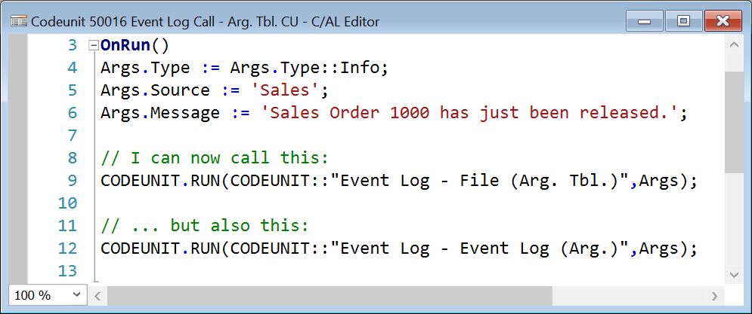
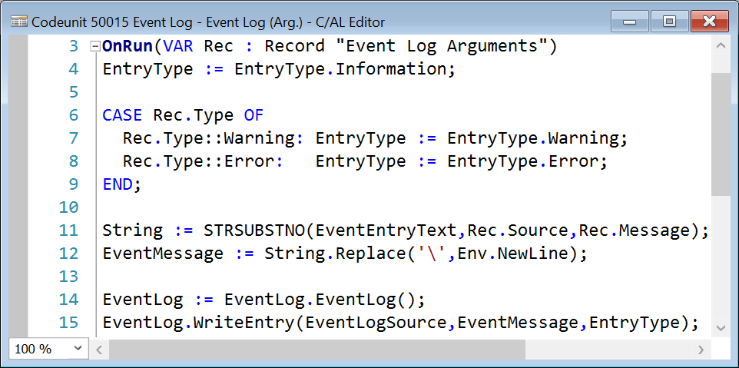
A Closer Look: Argument Table (Improved)

Slide 14
Facade Pattern
Specific Codeunit A
(called by facade)
Caller Object
(calls facade)
Facade Codeunit
(determines actual codeunit)
Specific Codeunit B
(called by facade)

Slide 15
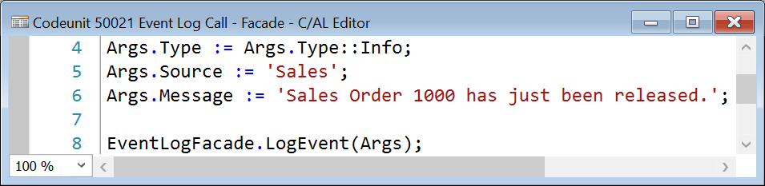
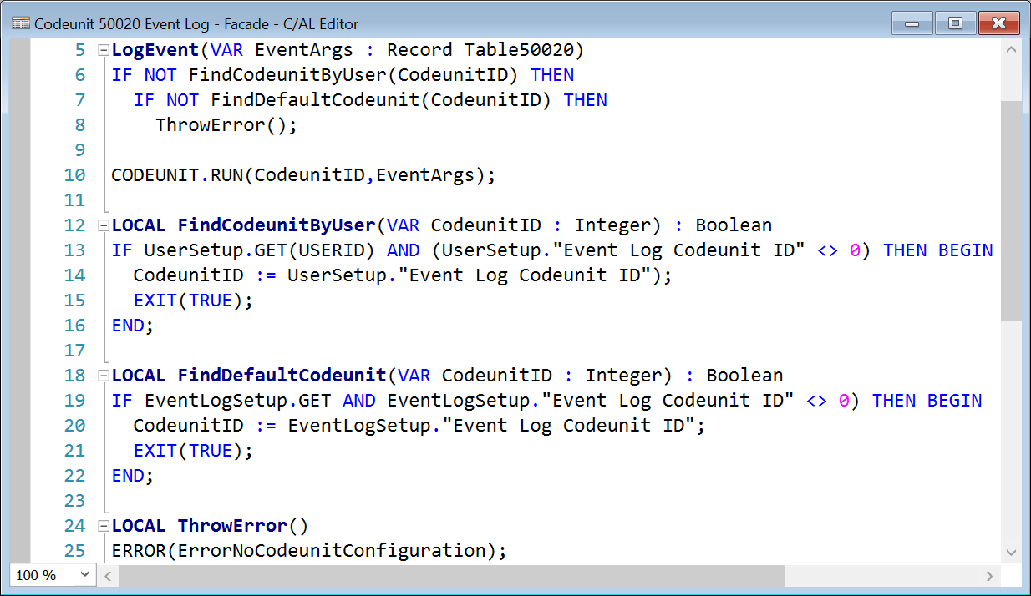
A Closer Look: Facade

Slide 16
Variant Facade Pattern
Specific Codeunit A
(called by facade)
Record
Variant
Caller Object
(calls facade)
Facade Codeunit
(determines actual codeunit)
Specific Codeunit B
(called by facade)

Slide 17
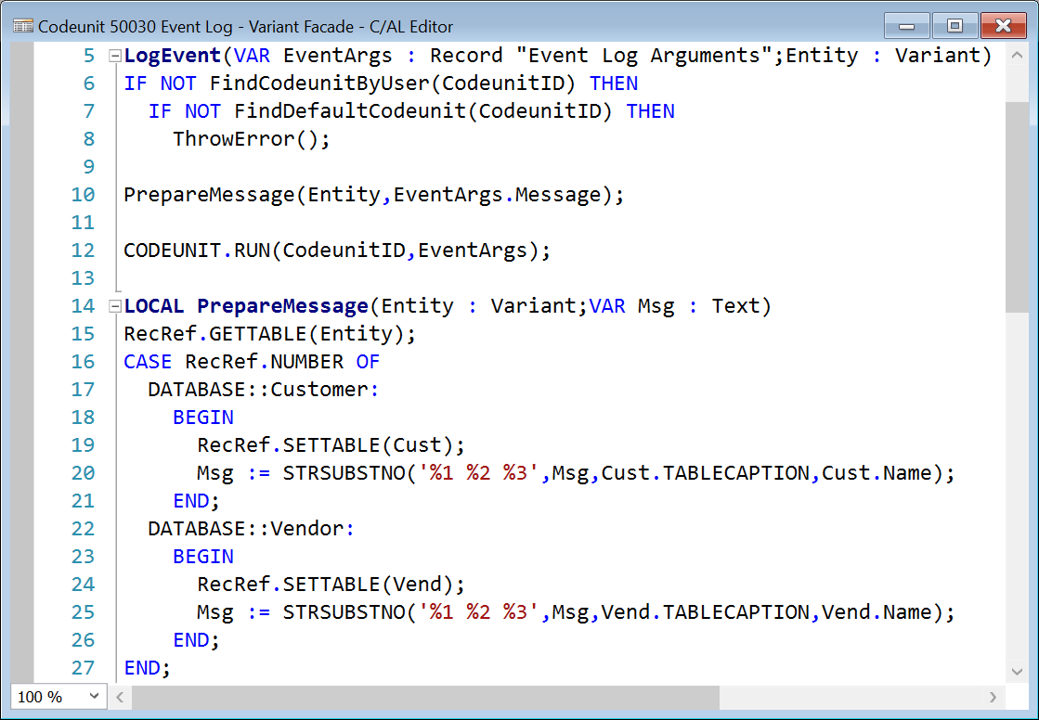
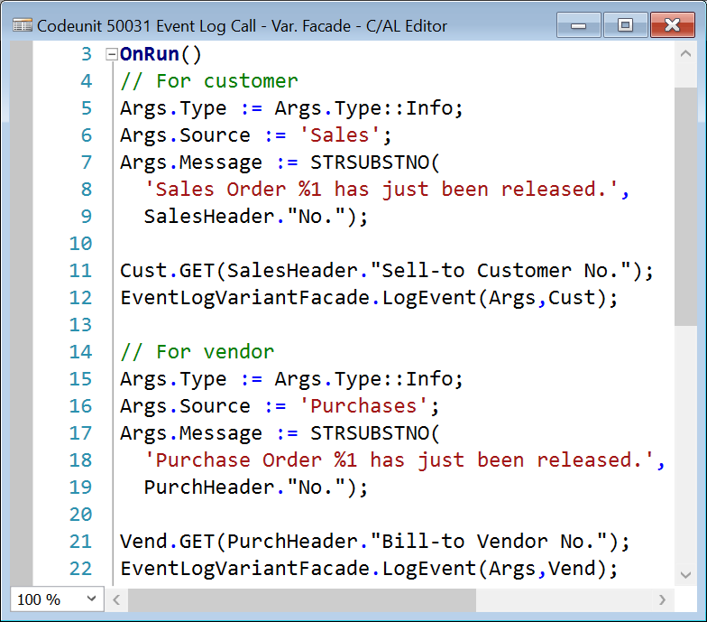
A Closer Look: Variant Facade

Slide 18
TempBlob Facade Pattern
Specific Codeunit A
(called by facade)
Caller Object
(calls facade)
Facade Codeunit
(determines actual codeunit)
(serialize)
(deserialize)
Specific Codeunit B
(called by facade)
TempBlob
(carries context)

Slide 19
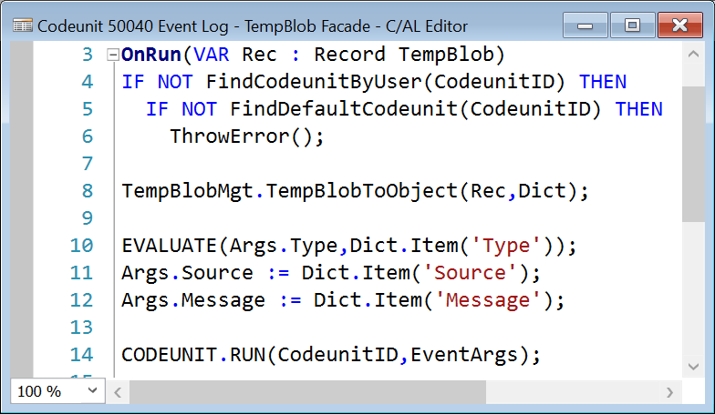
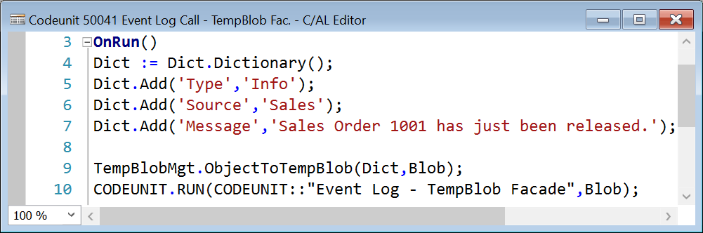
A Closer Look: TempBlob Facade
Serialization
Deserialization

Slide 20

And then we got
EVENTS

Slide 21
How Exactly Do Events Help?
”Handled” pattern:
https://nav-skills.com/2015/11/25/the-handled-pattern/

Slide 22
“Handled” Pattern
Subscriber 1
(subscribes to event)
Consumer Object
(needs a dependency)
“Handled” Facade
(publishes event)
(manages flow)
Subscriber 2
(subscribes to event)
invokes method
Subscriber n...
(subscribes to event)

Slide 23
“Handled” Pattern Flow
Publisher
Subscriber
Find subscriber codeunit in charge of the event
Call the event
Make sure that event was handled
Check if event is already handled
Check if this codeunit is in charge of the event
Execute logic
Set “handled” parameter

Slide 24
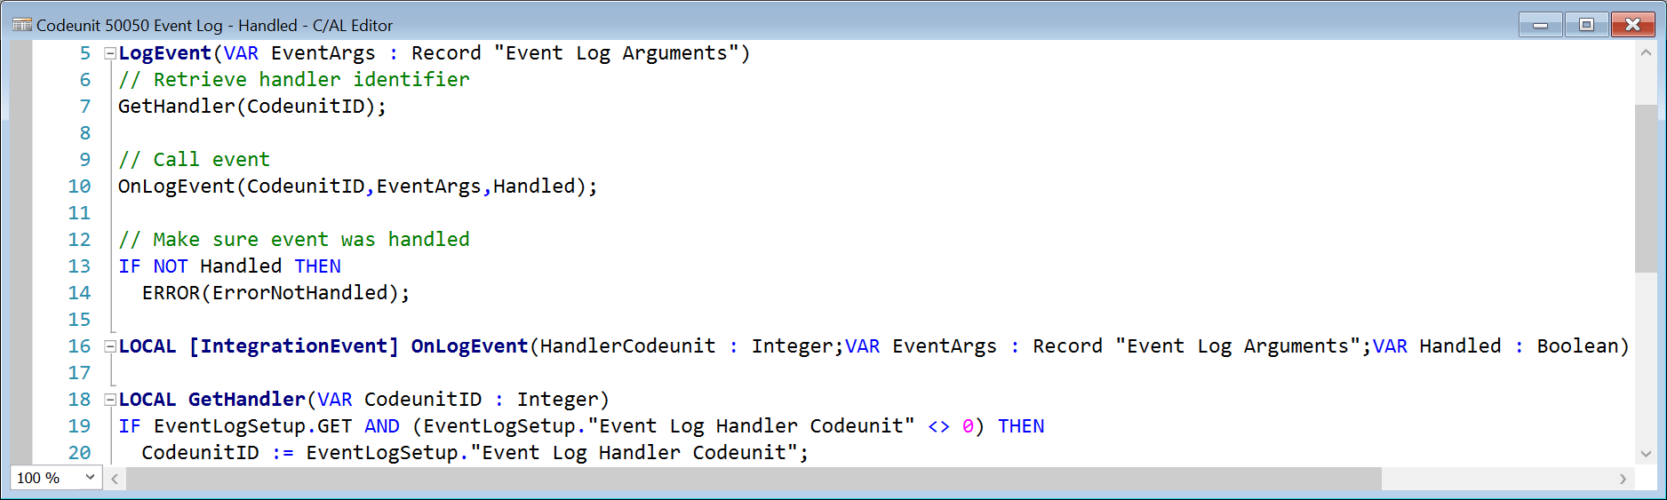
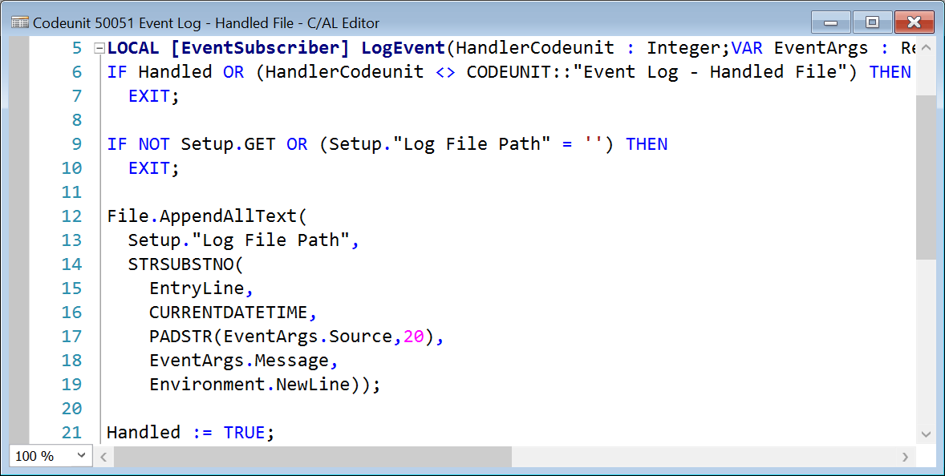
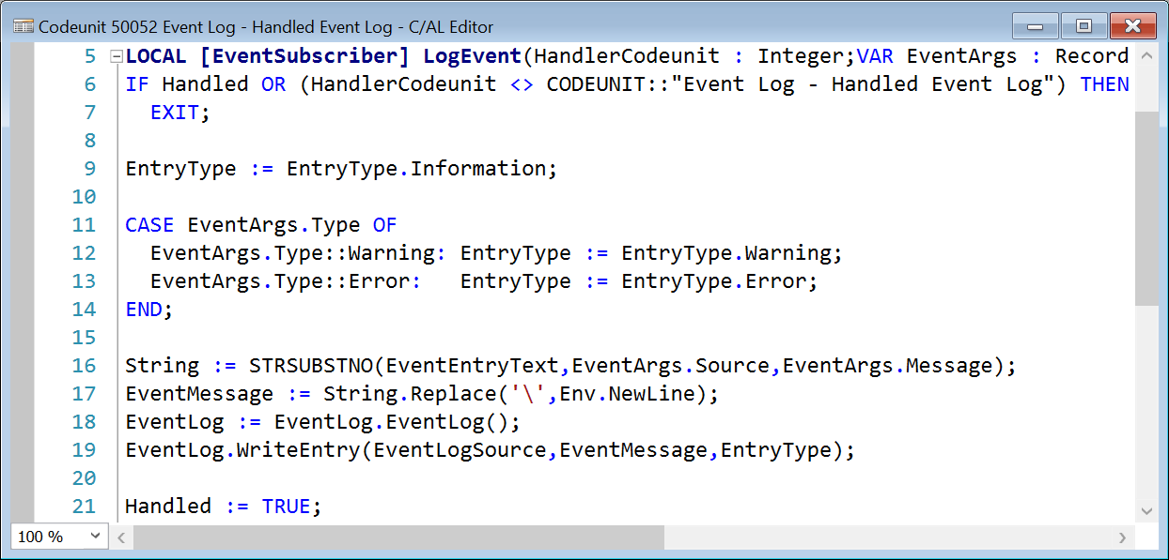
A Closer Look: “Handled” Pattern

Slide 25
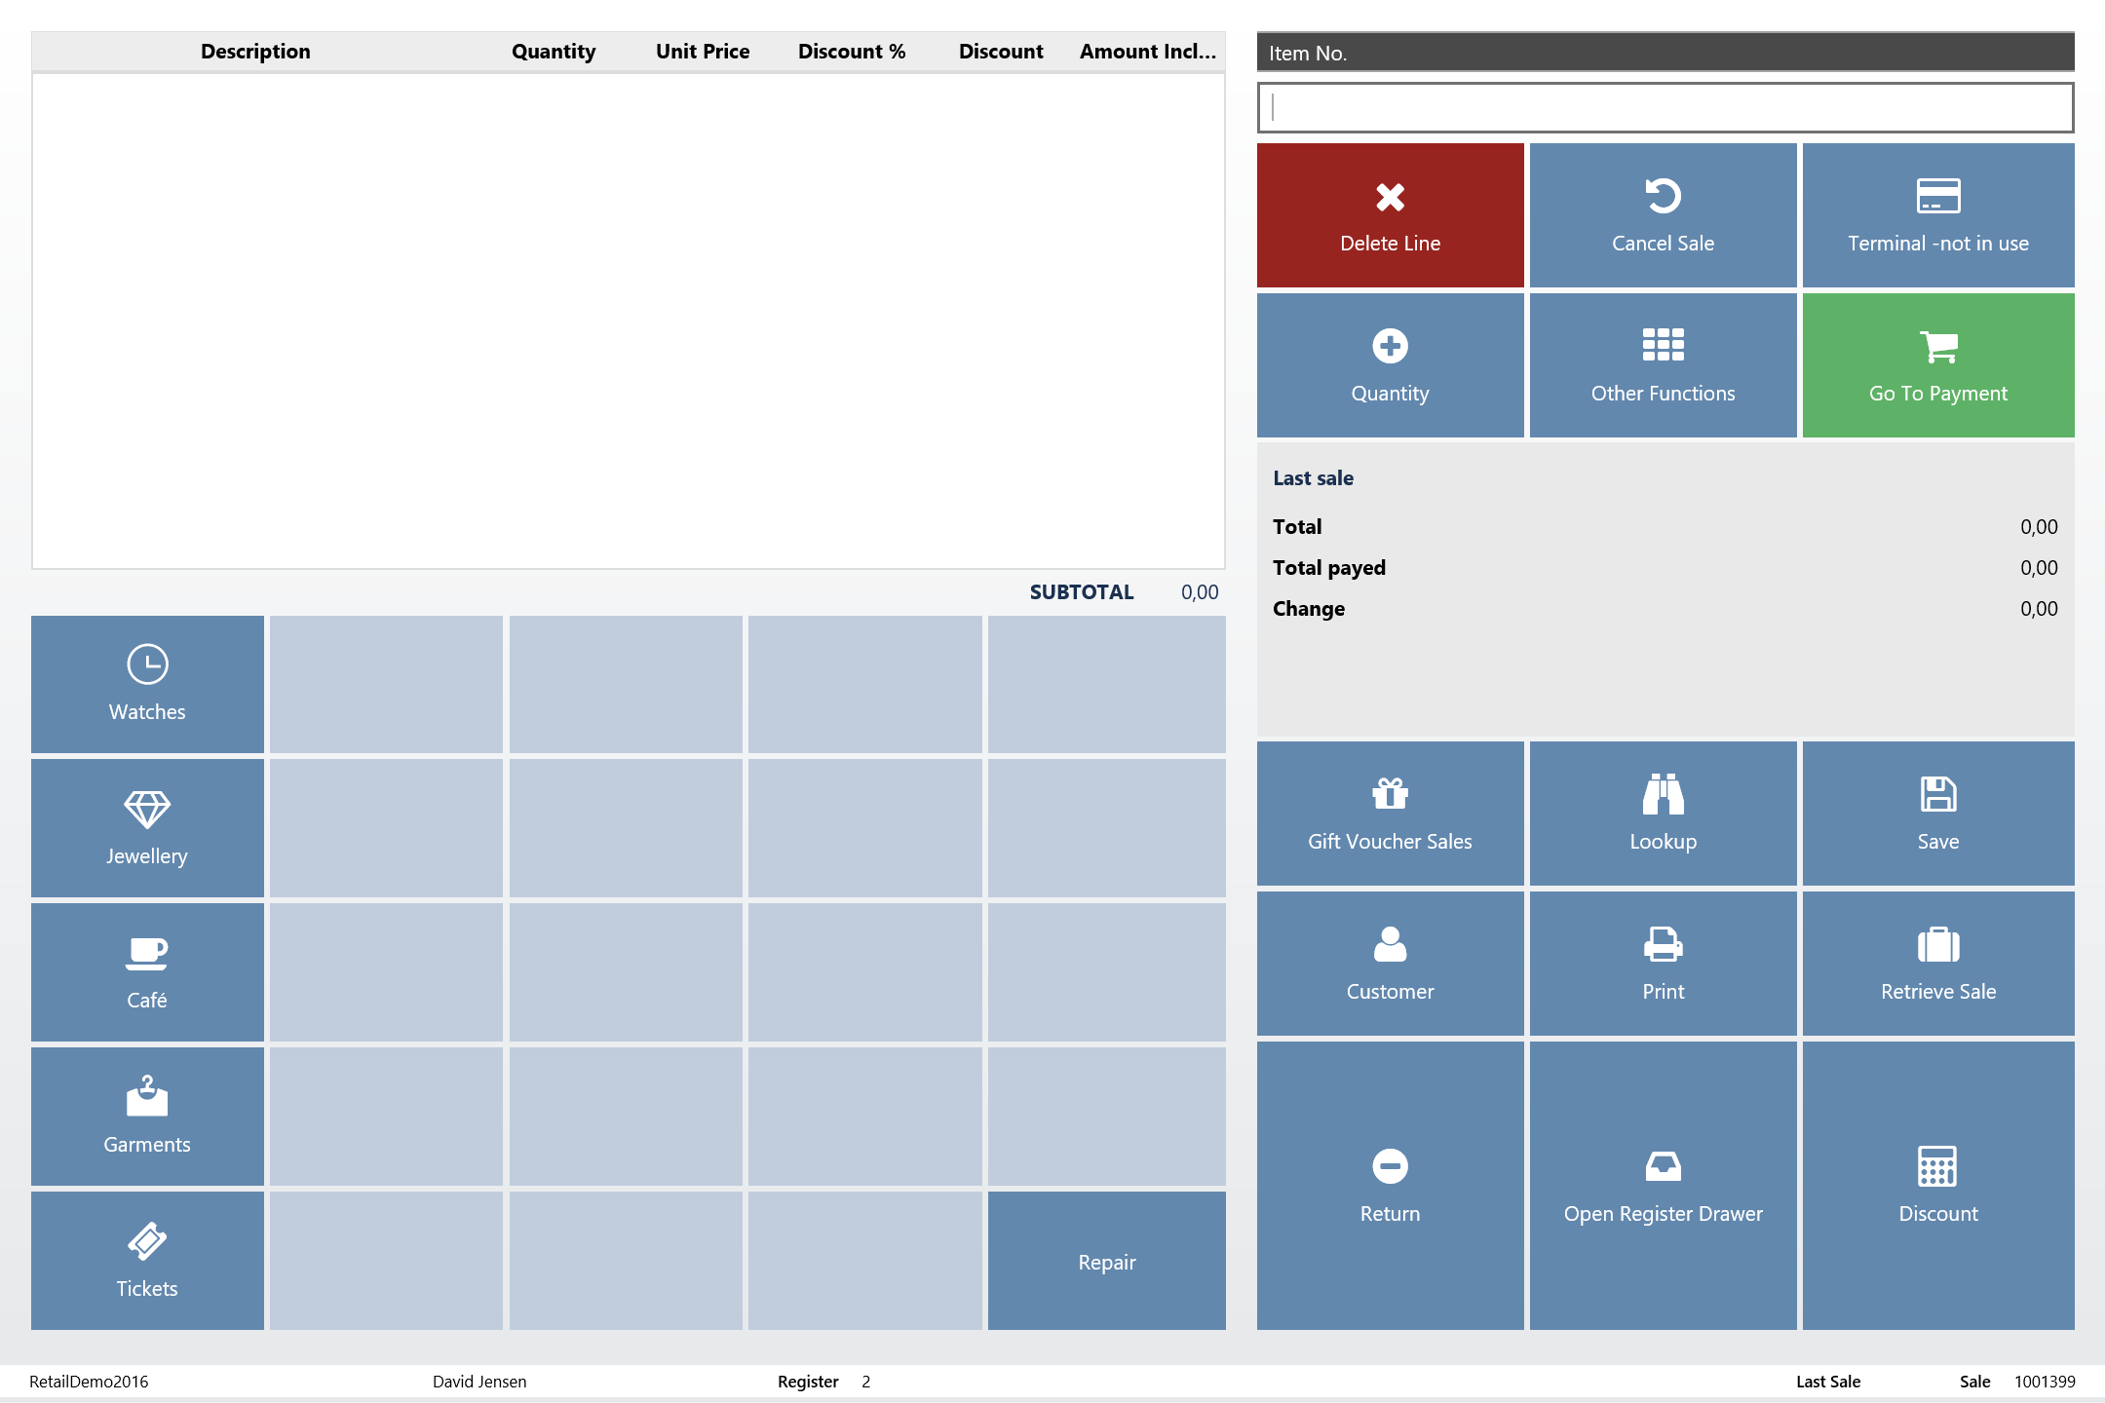
“Handled” in action

Slide 26
“Handled” Pitfalls
Subscriber identification
Multiple active subscribers
Cross-call state preservation
Infrastructure separation
Infrastructure fragility

Slide 27
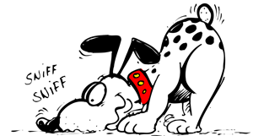
Let’s find a solution…

Slide 28
Manual subscriptions
Event subscriptions can be:
  Static (automatic) → each call in a separate, fresh codeunit instance
  Manual → each call in the same instance that was bound to events
Manage subscription
  BINDSUBSCRIPTION
  UNBINDSUBSCRIPTION

Slide 29
“Handled” Pitfalls after Manual Subscriptions
Subscriber identification
Multiple active subscribers
Cross-call state preservation
Infrastructure separation
Infrastructure fragility

Slide 30
Another event pattern can help…
Discovery Event
https://community.dynamics.com/nav/w/designpatterns/271.discovery-event

Slide 31
Discovery Event Pattern
Discovered modules
Module 1
(subscribes to discovery event)
Module 2
(subscribes to discovery event)
Discoverer
(publishes discovery event)
Module n...
(subscribes to discovery event)

Slide 32
“Handled” Pitfalls After Discovery
Subscriber identification
Multiple active subscribers
Cross-call state preservation
Infrastructure separation
Infrastructure fragility

Slide 33
Solution: Module Binder Pattern
Combines:
  Discovery Event Pattern
  “Handled” Pattern
Achieves:
  Logic and infrastructure separation
  Infrastructure stability

Slide 34
A Closer Look: Module Binder Pattern
Interface/Module Setup
Module
Module Manager
Binder Codeunit
(single instance)
(static binding)
Discovered interfaces
Discovered modules
binds
subscriptions
Consumer Object
(calls interface)
Interface / Facade
(publishes business logic event)
Logic Codeunit
(manual binding)
invokes

Slide 35
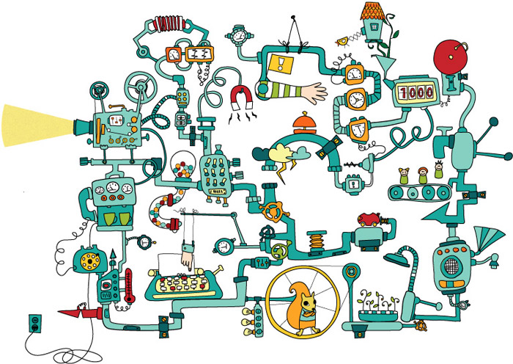

Slide 36
A Closer Look: Module Binder Pattern
Infrastructure
(static, does not change when new modules are provided)
Module
Binder Codeunit
(single instance)
(static binding)
discovery
event
binds
subscriptions
discovery
event
Consumer Object
(calls interface)
Interface / Facade
(publishes business logic event)
Logic Codeunit
(manual binding)
invokes
business logic
event

Slide 37
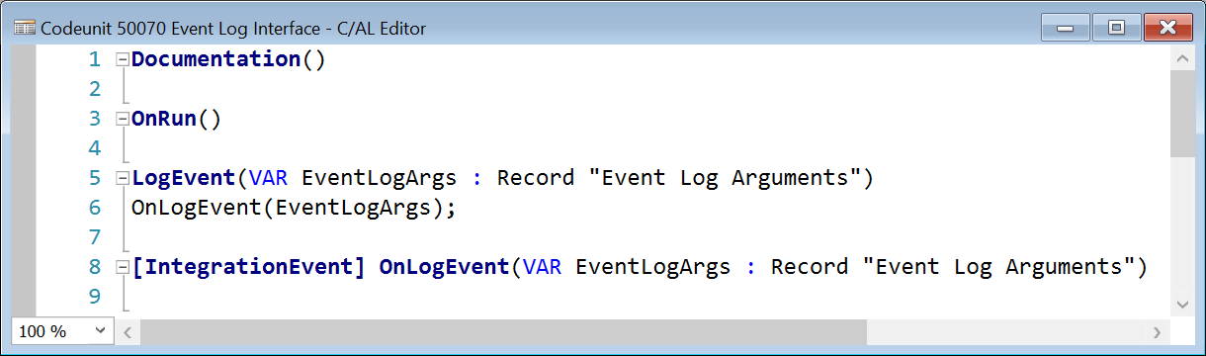
Interface
Interface / Facade
(publishes business logic event)
Facade for the business logic
Publishes business logic event

Slide 38
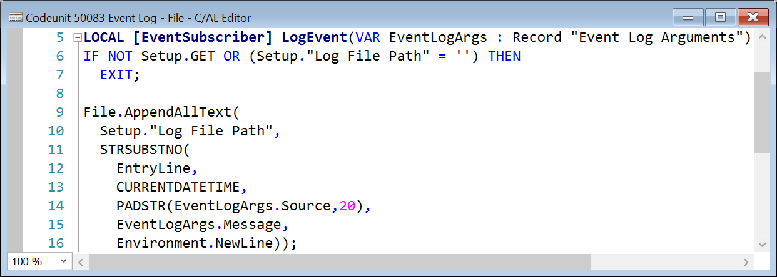
Module: Business Logic Codeunit
Logic Codeunit
(manual binding)
Subscribes to interface event
Executes specific business logic

Slide 39
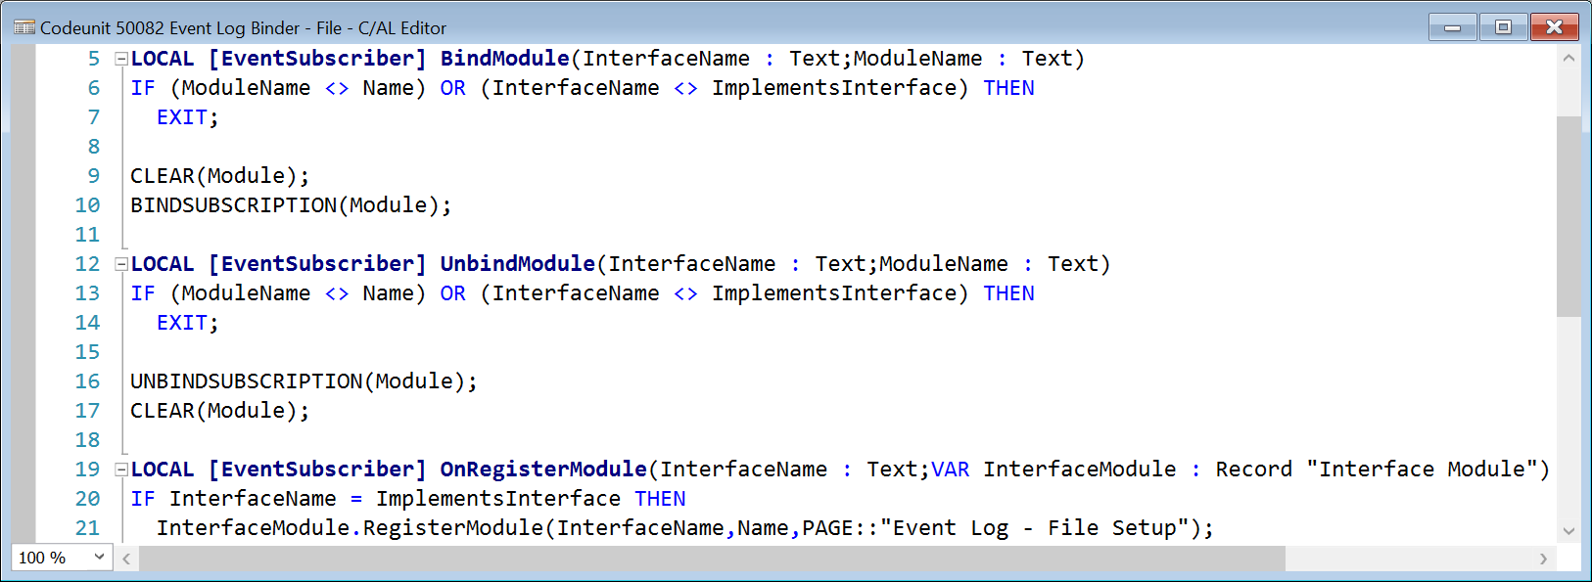
Module: Binder
Binder Codeunit
(single instance)
(static binding)
Binds/unbinds business logic codeunit
Discovers module for a specific interface

Slide 40
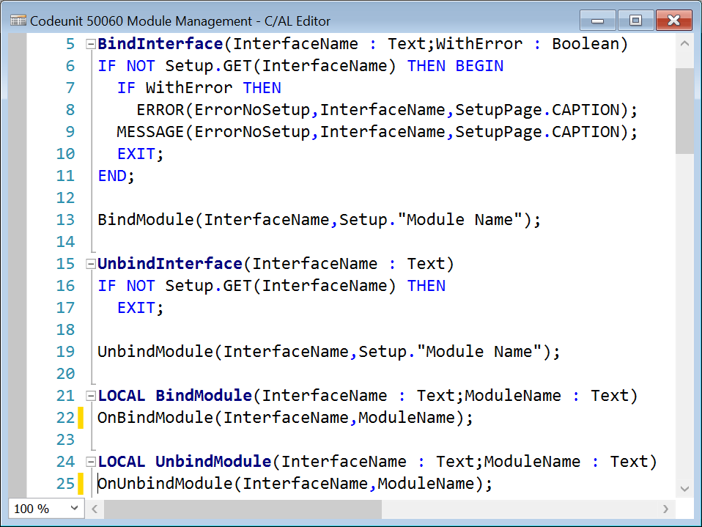
Module Manager
Module Manager
Handles discovery of interfaces and modules
Handles binding/unbinding of module binders

Slide 41
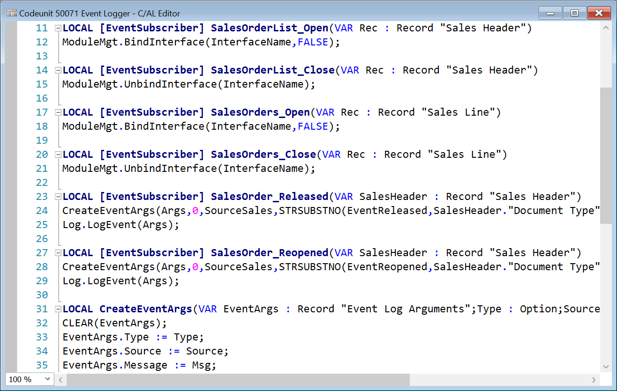
Consumer Codeunit
Consumer Object
(calls interface)
Invokes interface binding
Calls interface
Strictly speaking, this is not a part of the pattern, it is just an example

Slide 42
Demo
Interface / Module Setup

Slide 43
Challenges
Call multiplication
Explicit subscriptions
Rogue subscribers
Single subscribers

Slide 44
Solution
Use Event Subscription virtual table to:
  Verify that there are only manual subscribers
  Verify that there are active subscribers before calling the method

Slide 45
Demo
Module Binder Pattern in Action

Slide 46

To learn more...

Slide 47
Thank You!
Please remember to fill out your session survey using
the Directions 2016 Mobile App!

