Slide 1


Amazing the End User with JavaScript
Vjekoslav Babić
MVP, Microsoft Dynamics NAV

Slide 2






Slide 3


C/AL
JavaScript

Slide 4
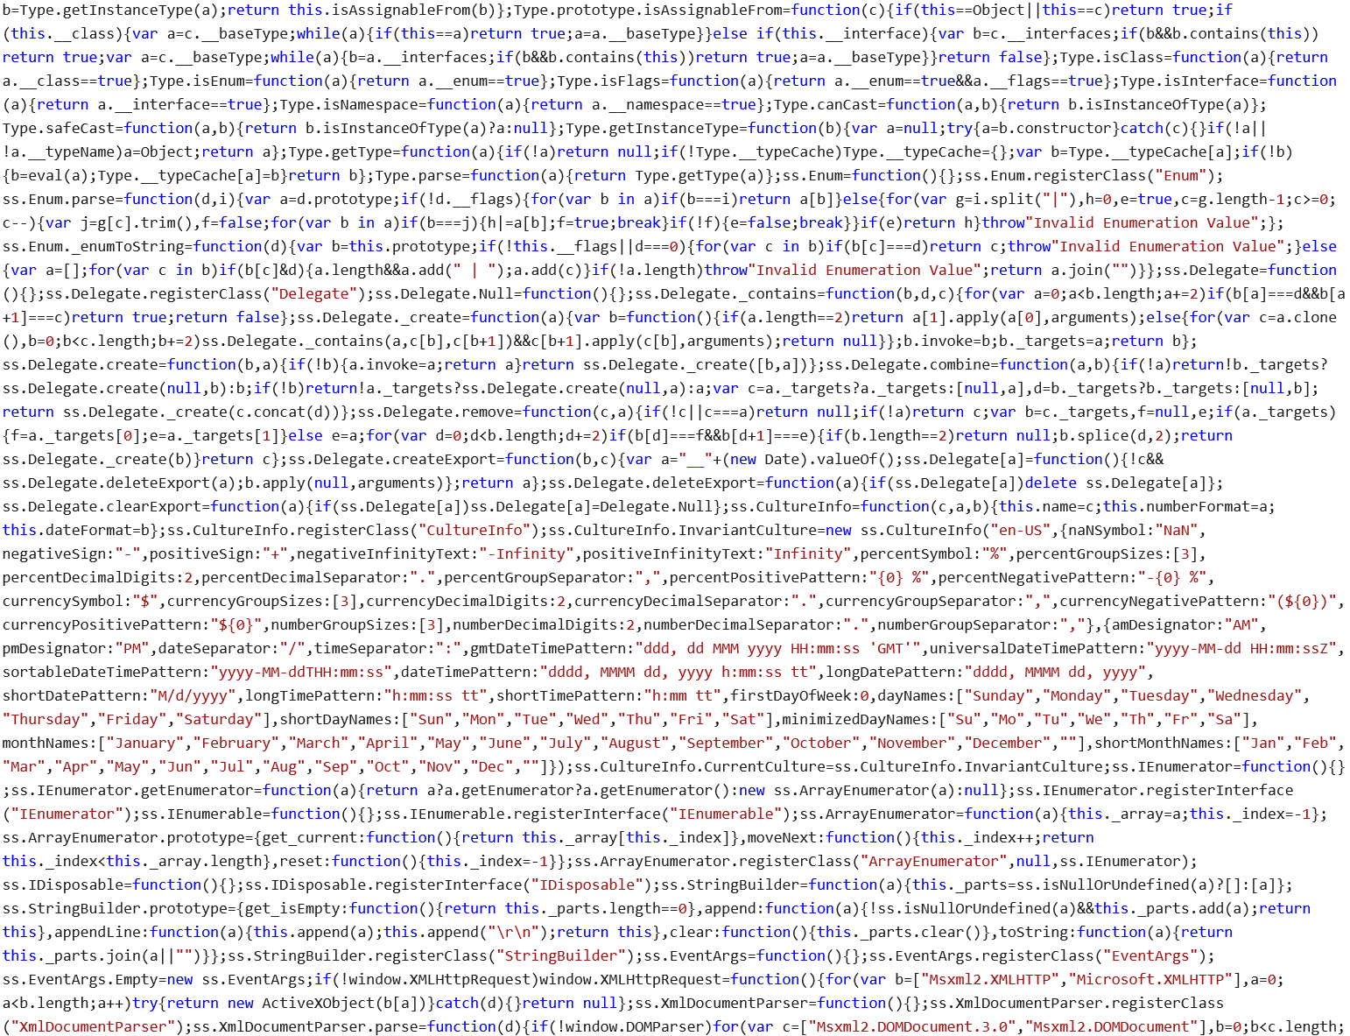

Slide 5


Slide 7



Slide 8
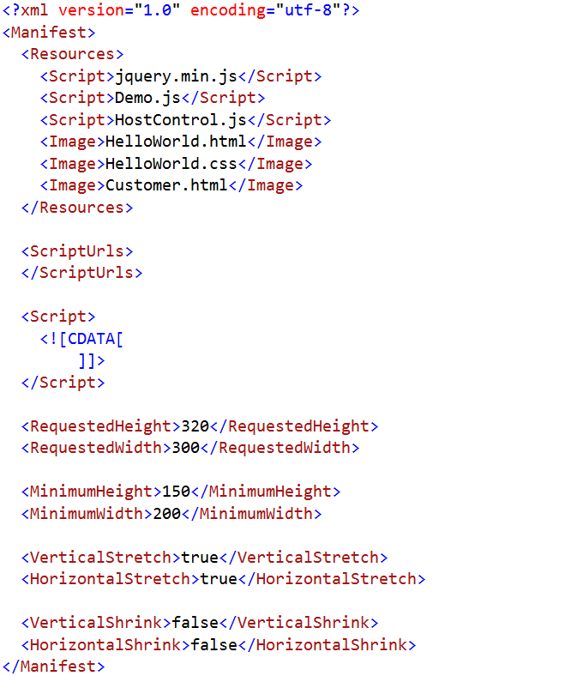
Manifest.xml

Slide 9
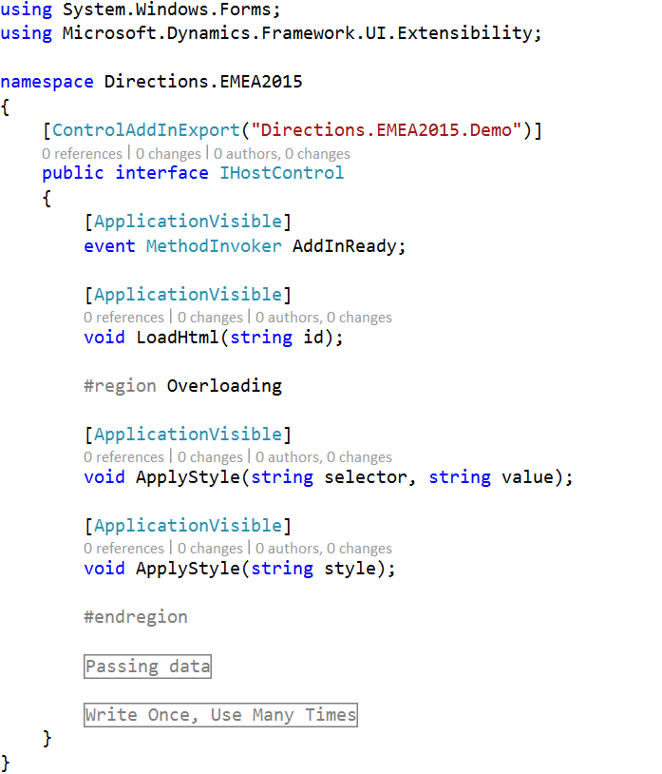
Interface

Slide 10
Deployment
Figure out the public key token
Create the Control Add-in record in NAV
Copy assembly .dll file to client add-ins folder
Zip all resource files together
Import the resource file into Control Add-in record
Repeat steps 3-5 for every change you make in interface or manifest/resource

Slide 11

One Step Deployment

Slide 12


What do we need?

Slide 13

Adding HTML

Slide 14
Adding CSS
.wife {
right: 100%;
margin: 0;
}

Slide 15

Overloading

Slide 16

Passing data

Slide 17

Asynchronous execution

Slide 18

Debugging

Slide 19
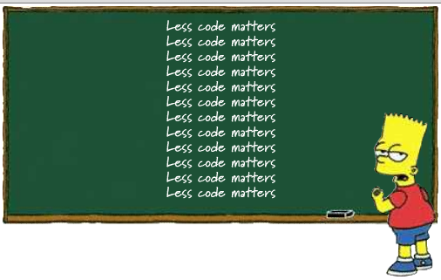
Multi-purpose Reusable Add-ins

Slide 20

Customizing .aspx files

Slide 21

Your worst enemy...

Slide 22

Thank You!

Slide 23
Join Us !

